Slide 1

KEYNESIAN CONSUMPTION FUNCTION
Macroeconomics

Slide 2
Introduction
Keynesian Economics developed during and after the Great Depression from the ideas presented by J. M. Keynes in his 1936 book, The General Theory of Employment, Interest and Money.
Keynesian Economics came up as a repudiation to the the aggregate supply-focused Classical Economics that preceded his works.
Keynesian Economics apples to short run.
He argues that output is strongly influenced by aggregate demand.
In the Keynesian view, aggregate demand does not necessarily equal the productive capacity of the economy; instead, it is influenced by a host of factors and sometimes behaves erratically, affecting production, employment, and inflation.

Slide 3
Psychological Law Of Consumption
Men are disposed, as a rule, and on the average, to increase their consumption as their income increases but not by as much as the increase in their income.
In other words,“ as income increases consumption increases but not by as much as the increase in income.”
Keynes recognized the role of subjective and objective factors including interest rate and wealth influence the level of consumption expenditure
But he argued it is the current level of income on which the consumption spending of an individual and the society depends.

Slide 4
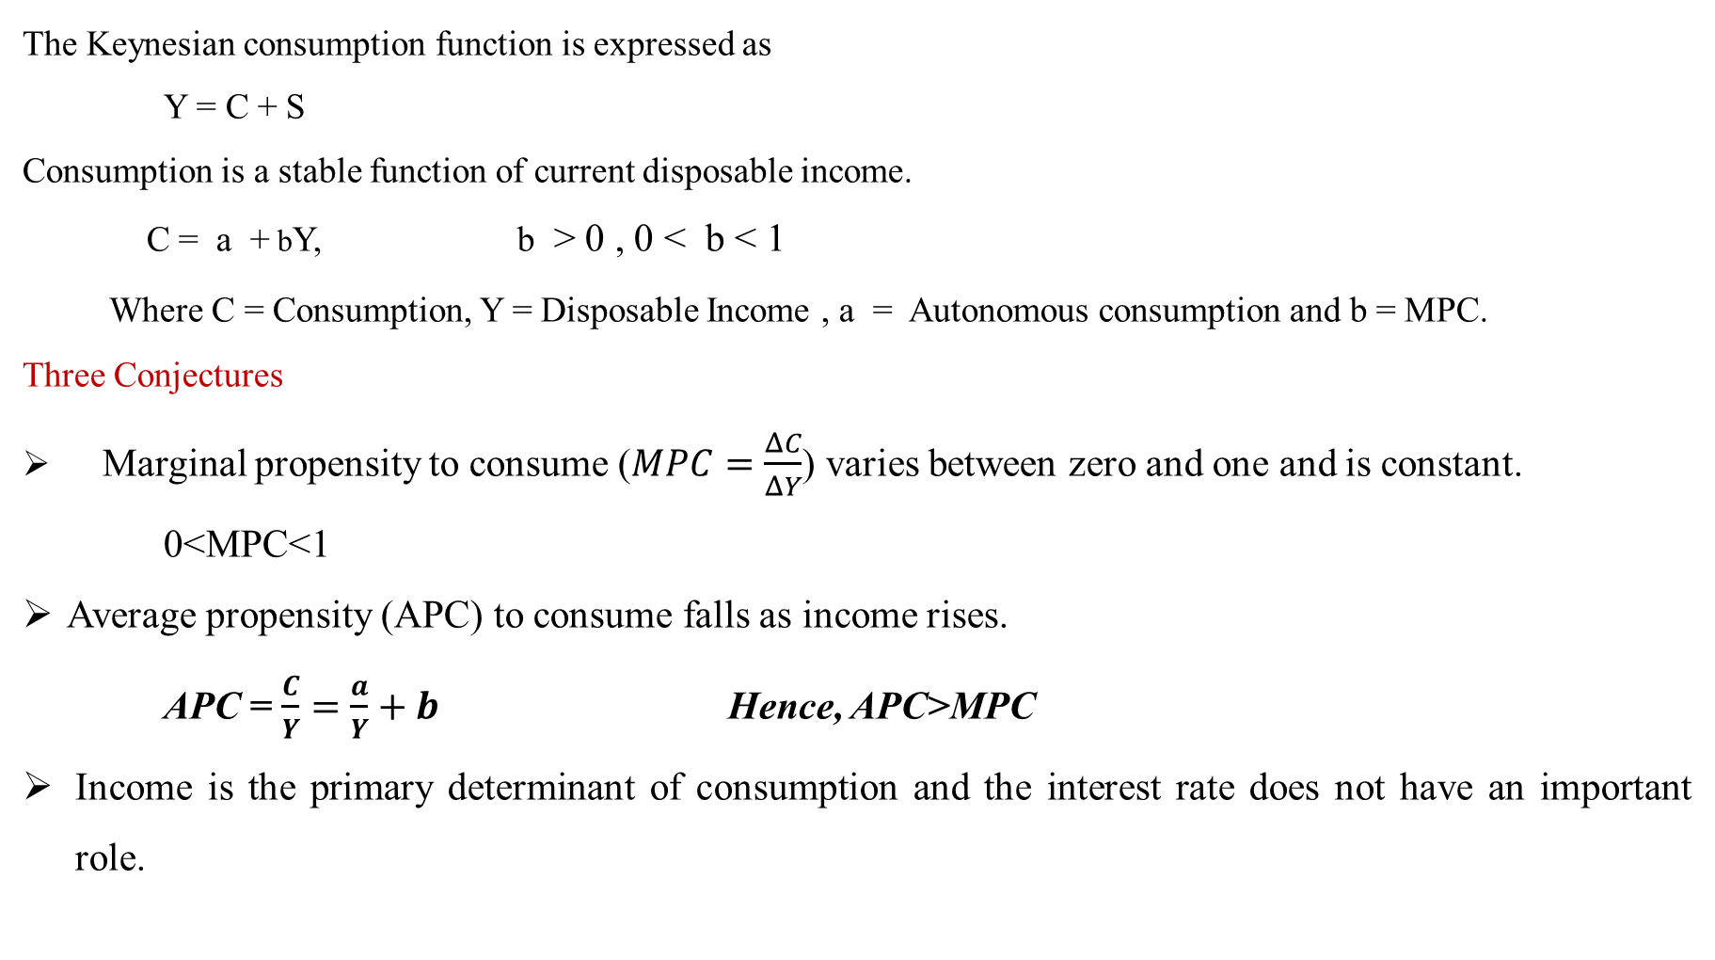
Consumption Function
The Keynesian consumption function is expressed as
Y = C + S
Consumption is a stable function of current disposable income.
C = a + bY, b > 0 , 0 < b < 1
Where C = Consumption, Y = Disposable Income , a = Autonomous consumption and b = MPC.
Three Conjectures
Marginal propensity to consume ($MPC=\frac{ΔC}{ΔY}$) varies between zero and one and is constant.
0<MPC<1
Average propensity (APC) to consume falls as income rises.
APC = $\frac{C}{Y}=\frac{a}{Y}+b$ Hence, APC>MPC
Income is the primary determinant of consumption and the interest rate does not have an important role.

Slide 6
Saving Function
S = Y – C
= Y – a – bY
S = – a + (1 – b)Y 0<1 – b<1
Thus MPS = 1-b
APS = –a/Y + (1– b) where 1 – b = MPS
Hence MPS>APS
MPC + MPS =1
APC + APS = 1
MPS>APS

Slide 7
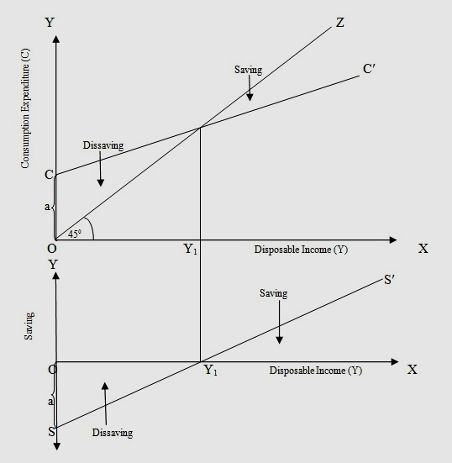
Saving Function

Slide 8
Implications
As an economy prospers, income goes up and so does the savings rate (APS).
Thus, prosperity leads to stagnation
Reasons
As Y goes up, APC goes down and APS goes up. Thus, consumption expenditure falls leading to fall in AD.
Savings do not lead to investment as the opportunities for investment may not be favorable.
This leads to increase in inventory, fall in production and then to stagnation (Secular Stagnation Hypothesis)

Slide 9
Early Empirical Successes: Results from Early Studies
Households with higher incomes:
⇒ MPC > 0
⇒ MPC < 1
⇒ APC ↓ as Y ↑
Very strong correlation between income and consumption
⇒ income seemed to be the main determinant of consumption

